Slide 1
PROJECT
ECOMMERCE JS-FRONT

Slide 2
AGENDA
1. Demo on website
2. Data structure of Application
3. Feature to explain
4.Test code

Slide 3

1. Demo on website
Click here

Slide 4
2. Data structure of Application
Name : text
Description : text
Price : number
Currency : text
Img : url

Slide 5
3. Feature to explain
Ticket | Score | Description | Status | Estimated | Actual Time | Due On
Update Product | 15 | Clicking a image update or button it will update product | Done | 3 | 8 | 30 November
Task | Ticket | Estimated | Actual Time
Subtask - 1 | css | 5min | 5min
Subtask – 2 … | Create table | 10min | 30min
Subtask-3 | Create variable and call function | 3h | 7h

Slide 6
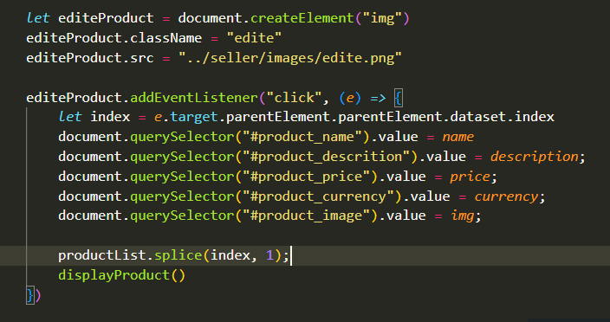
Code explain

Slide 7
4.Test Code
seller
Test Name | Test Description | Test Date | PASS / FAIL
Delete product | click on image delete | 04/12 | Pass
Update Product | click on image edit | 04/12 | Pass
Display product | I can see product after I create | 04/12 | Pass

Slide 8
Thank you !

